Slide 1

Housing Options and Resources:
Opening the Door to Recovery
MARYLAND DEPARTMENT OF HEALTH
Russell Springham, LCSW-C
Behavioral Health Administration, Clinical Services Division, Office of Evidence-Based Practice, Housing and Recovery Supports
Friday, Oct. 19, 2018

Slide 2
Overview
Behavioral Health Administration (BHA): Formally the Mental Hygiene Administration and the Alcohol and Drug Abuse Administration.
Core Service Agencies (CSA) Local Addiction Authorities (LAA) and Local Behavioral Health Authorities (LBHA): Located in local Health Departments or free standing agencies, they are local mental health and addiction authorities.
Administrative Service Organization (ASO): Beacon Health Options (managed behavioral health care — service authorization, claims, payments).

Slide 3
Current Housing Resources
Continuum of Care (COC) — formerly Shelter Plus Care
Residential Rehabilitation Program
Permanent Housing

Slide 4
Continuum of Care
Grand Total CoC: 305 units approved by U.S. Housing and Urban Development (HUD). Excluded are: Montgomery, Garret, and Howard Counties as well as Baltimore City
Grant funded program through HUD
Provides rental assistance for permanent housing to individuals and families with an adult member who has a mental illness or co-occurring disorder and is homeless
For more information on eligibility and how to apply, contact the CSA/LBHA of origin for the applicant

Slide 5
Permanent Supportive Housing
Permanent Supportive Housing (PSH): Housing for individuals served by the Public Behavioral Health System (PBHS) where the person is the lease holder. Housing units are subsidized or affordable. Services are available but not required, and can include offsite Psychiatric Rehabilitation Program, Mental Health Case Management, or Assertive Community Treatment/Mobile Treatment.

Slide 6
Residential Rehabilitation
Residential Rehabilitation Programs (RRP) — 50 programs statewide
Total number of RRP beds: 2,496
General Level beds: 863 | Intensive Level beds: 1,633
RRP:
Provides a home-like, supportive residential environment
Promotes the individual’s ability to engage and participate in appropriate community activities
Enables the individual to develop the daily living skills needed for independent functioning

Slide 7
Residential Rehabilitation
RRP has two levels of care: General and Intensive
General Level of Care: Minimum of 13 face-to-face services in the residence monthly.
Intensive Level of Care: Minimum of 19 face-to-face services in the residence monthly, with staff on site seven days per week, for a minimum of 40 hours per week.
Both levels of care have 24 hour/day on call staff availability.

Slide 8
Residential Rehabilitation
RRP is accessed by submitting an application to the CSA or LBHA of the county of residency
Eligibility is determined by the CSA/LBHA using the BHA priority population definition and medical necessity criteria applied by the ASO
The CSA/LBHA reviews applications, tracks vacancies, maintains waiting lists if necessary, and refers applications when beds become available
The RRP application is on the BHA website: http://bha.dhmh.maryland.gov/Pages/Forms.aspx

Slide 9
Specialty RRP Housing
Transition Age Youth (TAY) | Baltimore City, Baltimore, Calvert, Carroll, Charles, Frederick, Howard, Montgomery, Prince George’s, St Mary’s, and Wicomico Counties
Developmental Disability/Mental Health (DD/MH) | Anne Arundel, Carroll, Frederick, and St. Mary’s Counties
Integrated Treatment for Co-Occurring Disorders (ITCOD ) | Frederick and Montgomery Counties
Deaf and/or Hard of Hearing | Baltimore City, Anne Arundel, Baltimore, Frederick, and Prince George’s Counties
Geriatric | Baltimore City, Anne Arundel, Frederick, Prince George’s, and Wicomico Counties

Slide 10
PSH
Public behavioral health systems are required by federal law to provide services in integrated community settings (U.S. Supreme Court, Olmstead vs. LC). PSH is an evidence-based practice (EBP) for assisting persons with severe mental illness find and maintain housing in integrated settings in the community of their choice.
EBP toolkit for PSH on the SAMHSA website:
http://store.samhsa.gov/product/Permanent-Supportive-Housing-Evidence-Based-Practices-EBP-KIT/SMA10-4510

Slide 11
PSH Key Elements
Tenants having a lease in their own name and the full rights of tenancy under landlord-tenant law
Leases do not have any special provisions that would be found in the leases of someone without a mental health disability
Support services are available and accessible, but are voluntary, and not required, so a person cannot be evicted for refusing services
Rules within the housing are the same as for persons without mental health disability, and do not restrict who may visit or interfere with the person’s life within the community

Slide 12
PSH Key Elements
The housing is not time-limited and the lease is renewable at the tenant’s or owner’s option
Prior to moving into PSH, tenants are asked about housing preferences, and are offered the same range of choices available to others at their income level in the same housing market
Housing is affordable with tenants paying no more than 30 percent of their household income toward rent and basic utilities (gas, electric, water)
Housing is integrated, best achieved in scattered-site locations throughout the community, in order to live in communities or buildings where a majority of persons do not have a mental health disability

Slide 13
PSH Key Elements
Tenants have choice about the support services they receive, being offered a range of services, most frequently including Assertive Community Treatment (ACT) or intensive case management. And all such services are focused on a person-centered approach
As the tenants’ needs change over time, they can receive more or less intensive services without losing their housing
Support services are designed to promote recovery and help tenants to choose, acquire, and keep housing
And finally, the provision of housing and support services are distinct, being provided by separate property management and support services; or if by staff from the same agency, those persons and roles do not overlap

Slide 14
Approach Methods
Approaches to helping PSH tenants find affordable housing include:
Project-based rental assistance: Housing subsidies tied to a particular unit and tenants who chose to live in those units pay a reduced rent
Sponsor-based rental assistance: A non-profit agency receives support to buy or lease housing that is then leased to qualified tenants
Tenant-based rental assistance: A tenant receives a voucher, entitling the tenant to a reduced rent, which can be used to rent a unit of the tenant’s choice from a landlord who agrees to accept the voucher

Slide 15
Approach Methods
The three approaches can be used to provide services to tenants in two types of settings:
Single-site housing is housing in which tenants who receive support services live together in a single building or complex of buildings, with or without on-site support services
Scattered-site housing is housing in which tenants who receive support services live throughout the community in housing that can be agency-owned or privately-owned

Slide 16
Person-Centered Assessment
Person-centered, face-to-face interview
Identify: Strengths, assets, preferences, needs, challenges
Educate about housing options to ensure informed choice
Develop strategies for accessing programs

Slide 17
Common Challenges
Common challenges and barriers to accessing housing for people with disabilities include:
Lack of affordable housing in Maryland
Social Security Income (SSI) maximum benefit amount below Federal Poverty Level (FPL) ($750/month)
Criminal background checks
Credit checks and rental histories
Utility arrearages
Lack of needed documentation: (Social Security card, Social Security Administration (SSA) award letter, Photo ID, Birth Certificate, income verification, etc.)
Housing waiting lists

Slide 18
Documentation
Housing Documentation Checklist (work on this sooner, rather than later):
Birth certificate (all household members) http://dhmh.maryland.gov/vsa/Pages/birth.aspx
Valid government-issued photo ID (passport or state ID)for all household members over 18
Social Security card (all household members)
Proof of citizenship/legal status (if applicable)
Child custody — Court documentation showing custody or guardianship (if applicable)
Divorce decree or separation agreement (if applicable)

Slide 19



Identifying Challenges
Identify any challenges to accessing housing programs as soon as a person expresses interest in applying:
Credit
Criminal
Personal Rental History

Slide 20
Overcoming Credit Issues
Credit is one of the primary factors that property managers consider when determining whether or not to accept an applicant. We help:
Obtain a free copy of his/her credit report/understand this information
Access legal services if needed (e.g., local Legal Aid office)
Identify community resources to assist with paying outstanding debt (e.g., faith-based organizations)
Notes:
Diane

Slide 21
Overcoming Credit Issues
(continued)
4. Contact a previous landlord or creditor to request a waiver or reduction in payment of debt
5. Determine if a disability or medical issue impacted a person’s ability to maintain good credit
6. Write a letter requesting a reasonable accommodation from the landlord regarding disability-related credit issues
Notes:
Diane

Slide 22
Overcoming Criminal Background
Case managers should be familiar with how to assist a person to review a criminal record, expunge a criminal record, and submit a reasonable accommodation request.
Action steps include:
Step 1: Develop a trusting relationship
Step 2: Explore the person’s past in order to potentially obtain housing
Step 3: Check Maryland Judiciary Case Search system and verify accuracy
Step 4: Remove open warrants and seek legal counsel if necessary
Notes:
Diane

Slide 23
Overcoming Criminal Background
(continued)
Step 5: Help the person understand rules/policies regarding criminal activity and housing
Step 6: Determine if a change in health/medical situation influenced the behavior
Step 7: Support commitment to acceptance of rehabilitation or other supports/services
Step 8: Assist with connecting to community resources
Notes:
Diane

Slide 24
Overcoming Rental History
Case managers should be familiar with how to review rental history and present extenuating circumstances. Action steps include:
Step 1: Identify past challenges to rental history
  Eviction record?
  Trouble paying rent on time?
  Difficulty getting along with neighbors?
  Ability to maintain a safe living environment?
  Ability to understand tenant obligations?
Notes:
Diane

Slide 25
Overcoming Rental History
(continued)
Step 2: Determine if a person’s health, medical, or disability situation impacted tenancy
Step 3: Help the person to write an explanation of circumstances
Step 4: Reach out to previous landlord to obtain a positive reference
Step 5: Assist with connecting to community’s supports/services to overcome current/future challenges to rental history
Notes:
Diane

Slide 26

Reasonable Accommodation

Slide 27

Reasonable Accommodation
Reasonable Accommodation is a change, exception, or adjustment to a rule, policy, practice, or service that may be necessary for a person with a disability to have an equal opportunity to use and enjoy a dwelling.
Reasonable Accommodations require a housing provider to do more: They must make changes in rules, procedures, policies, practices, or services if necessary to afford a person with a disability equal opportunity to use and enjoy a dwelling.

Slide 28




Reasonable Accommodation
Applying for housing
Screening: Credit, criminal background, rental history
Household members: Live-in aide, Service or Emotional Support Animals
Searching for housing: Search time, high rents, number of bedrooms, acceptable housing types

Slide 29
Reasonable Accommodation
If you need a reasonable accommodation, you must ask for it.
Put your request in writing to the property owner and keep a copy
Request must share the fact that you have a disability (you need not share details about your disability)
Describe what you want changed and why you need to have the change

Slide 30
Reasonable Accommodation
In most cases, a property owner has the right to ask for proof that you need the reasonable accommodation. Your medical provider or case manager can write a letter on your behalf
Use My Sample Letter for Requesting a Reasonable Accommodation to plan such a letter. Keep a copy of your letter, and be sure it has the date

Slide 31
Moving Prep
Plan, plan, plan …
Identify key individuals
Connect with everyone who will be involved
Plan a meeting to identify roles and responsibilities of everyone involved in the transition/move
Identify items needed for the transition

Slide 32
Moving Prep
At the meeting, the following questions should have been answered:
What is the date and time of the transition/move?
How will the participant get to their new residence?
Who will help them pack and move their belongings?
Do they have a local pharmacy and will their medication be ordered prior to the move?
Have medical appointments been scheduled with primary care and mental health providers in the community?
Do they have a checking/savings account set up?
Do they have their security deposit?

Slide 33
Good Tenancy
Paying rent on time
Maintaining the unit
Engaging in friendly neighbor relationships
Complying with the terms of the lease
Communicating with the property manager
Understanding tenant responsibilities

Slide 34
Good Tenancy
(continued)
Knowing who to call and when to call these individuals
My Own Front Door: A handbook for people with disabilities on becoming a tenant and staying housed
http://mdod.maryland.gov/housing/Documents/My%20Own%20Front%20Door%20finalPWP.pdf

Slide 35
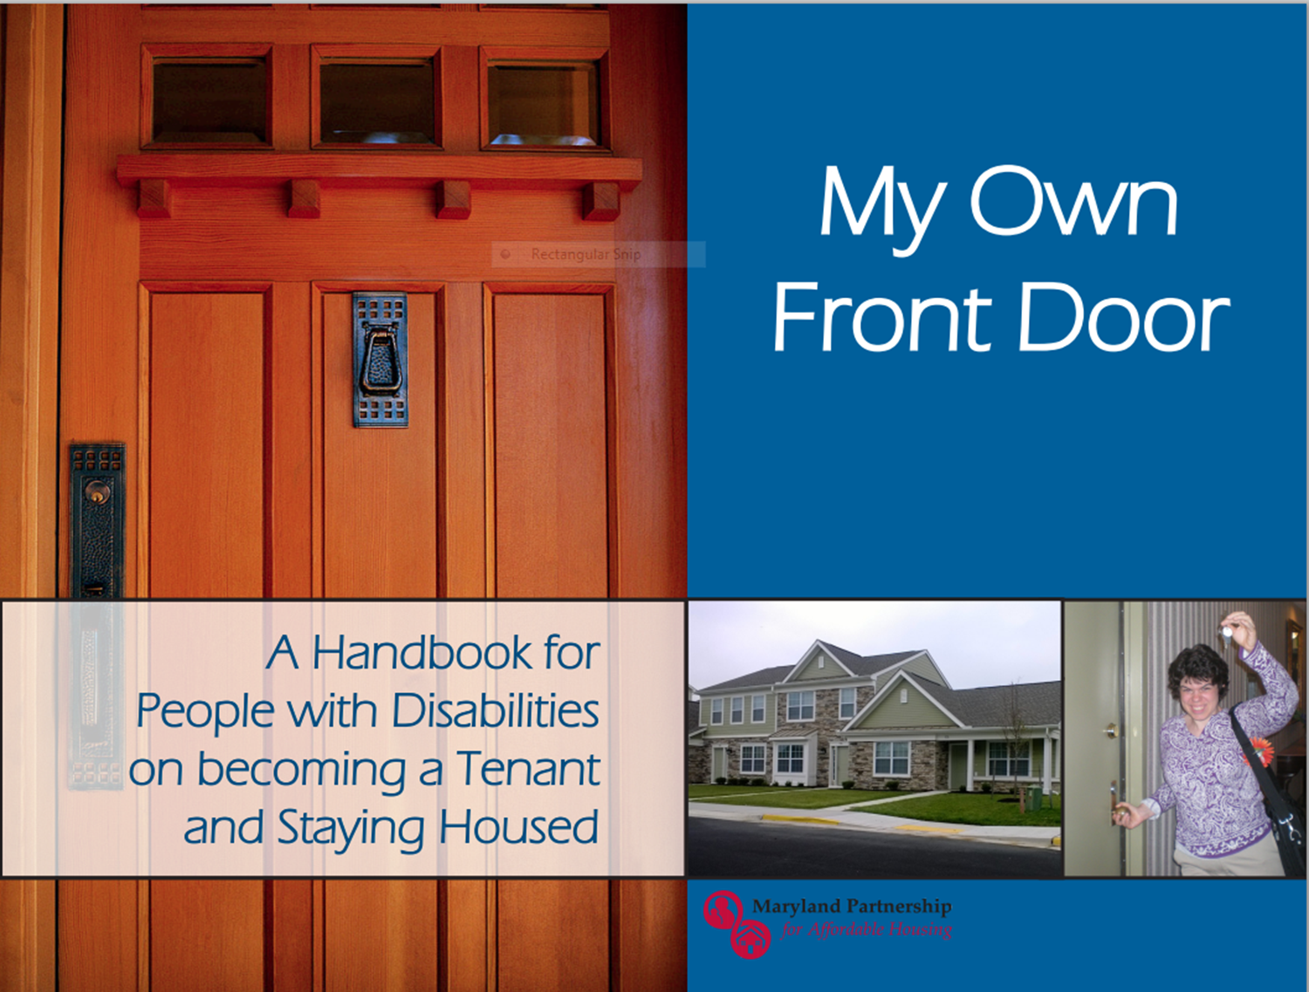
Notes:
Diane

Slide 36
Maryland Housing Initiatives
Weinberg Initiative
Housing First Pilot Project
Section 811 Project Rental Assistance (PRA)

Slide 37
Weinberg Initiative
The Affordable Rental Housing Opportunities Initiative for Persons with Disabilities
Partnership between The Harry and Jeanette Weinberg Foundation and the state
Provide affordable rental housing options for persons with disabilities
Seeks to increase accessible, affordable, and independent housing opportunities

Slide 38
Weinberg Initiative
(continued)
FUNDING
House non-elderly, disabled persons at 15-30 percent of Area Gross Median Income (AGMI)
Eligibility criteria includes the ability of a tenant to pay up to 30 percent of their income in rent

Slide 39
Housing First Pilot
BHA and Behavioral Health System Baltimore, in collaboration with the Montgomery County and Prince George’s County LBHAs:
Developed and implemented the Housing First Project
Serve individuals in Baltimore City, Montgomery County, and Prince George’s County
This project provides assistance to 72 individuals to locate, secure, and maintain permanent housing
Notes:
Providers include Healthcare for the Homeless in Baltimore City and People Encouraging People in Montgomery and Prince Georges Counties.

Slide 40
Housing First Pilot
Services include:
Housing advocates that assist individuals in securing housing and communicating with landlords, and provide supported housing services to help individuals maintain housing
Housing inspections to ensure housing quality
Representative payee services for individuals who are required to have a payee by the SSA
Housing subsidies to assist in making housing affordable for those in the program

Slide 41
Housing First Pilot
Eligible individuals: Those with mental illness or a mental illness and a co-occurring substance use disorder who are:
Homeless or at risk for homelessness and served by the Supplemental Security Income/Social Security Disability Insurance (SSI/SSDI) Outreach Access and Recovery (SOAR) Program
To be discharged from a state psychiatric hospital to live in any of the three jurisdictions
Transitioning from a RRP in any of the three jurisdictions to permanent housing
Additionally, all individuals served through this project must have incomes at least 50 percent below the area median income (AMI).

Slide 42
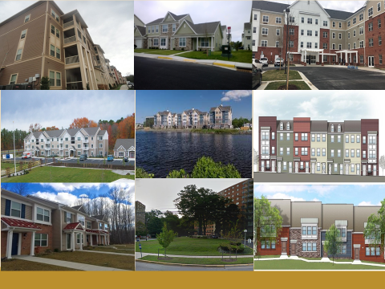

Section 811 PRA

Slide 43










Section 811 PRA
Notes:
Diane

Slide 44
Affordable Housing Partners
The Maryland Partnership for Affordable Housing (MPAH):
Began in 2011 with grant funding from the Centers for Medicare and Medicaid Services (CMS) and HUD
Collaborative partners included the Maryland Department of Health’s BHA and Developmental Disabilities Administration (DDA), Money Follows Person, Department of Housing and Community Development (DHCD), Maryland Department Of Disabilities (MDOD), Centers for Independent Living (CILS), consumer organizations, and housing developers
Implementation and maintenance of an internet-based affordable housing registry through DHCD and MDOD at www.mdhousingsearch.org and www.socialserve.com

Slide 45
Affordable Housing Partners
(continued)
Applied to HUD for Section 811 PRA Demonstration Project was awarded $20.7 million between two awards to develop 300 units of HUD 811 Project-based rental assistance
DHCD is currently working with MPAH housing developers to create or rehab existing housing and are training case managers to assist individuals. The Social Serve registry is used to determine eligibility and place individuals on waiting lists
811 housing first became available in 2016 and 2017 and will continue through 2019

Slide 46
811 PRA Overview
Goal: 300 permanent supported housing units
Program Type:
  Project Based Rental Assistance
  Located in multi-family housing developed with affordable housing development funds
  Integrated — no more than 25 percent of units designated for people with disabilities

Slide 47
811 PRA Overview
  Eligible Applicants:
  Age 18 to under age 62 at time of leasing
  Disabled as defined by HUD
  Medicaid recipients
  Income at or below 30 percent AMI — includes SSI level income
  Tenant Rent Contribution:
  30 percent of income for rent and utilities combined

Slide 48
811 PRA Population
Institutionalized: Nursing facility, Intermediate Care Facilities for Individuals with Intellectual Disability, state psychiatric hospital or hospital where assistance is available under Medicaid
At risk of institutionalization due to current housing situation: Homebound or deplorable housing conditions
Moving to independent renting: DDA Community Pathways waiver Group Home and Assisted Living Unit, Brain Injury Waiver ALU, BHA Residential Rehabilitation Program

Slide 49
811 PRA Population
(continued)
4. Homeless (as defined by HEARTH Act) in this order:
Actually homeless
Imminent risk of homelessness
Homeless under other Federal statutes (i.e., unaccompanied youth/families with youth)
Fleeing domestic violence

Slide 50
811 PRA Units
County | Property | Location | Total 811 Units | 1 BR | 2 BR | Estimated Leasing Start
Anne Arundel | Berger Square | Odenton | 8 | 0 | 8 | Fully leased
Anne Arundel | Towne Courts | Annapolis | 6 | 4 | 2 | Early 2019
Baltimore City | Riviera | Baltimore City | 5 | 4 | 1 | May 2018 – outreach in process
Baltimore City | 300 North AKA Warwick Apts. | Baltimore City | 12 | 8 | 4 | Summer 2018
Baltimore City | East Baltimore Historic III | Baltimore City | 2 | 2 | 0 | July 2018 – outreach in process
Baltimore City | Greenmount & Chase | Baltimore City | 9 | 9 | 0 | Summer 2019
Baltimore City | Walbrook Mill | Baltimore City | 10 | 10 | 0 | Spring 2019

Slide 51
811 PRA Units
County | Property | Location | Total 811 Units | 1 BR | 2 BR | Estimated Leasing start
Baltimore | Merritt Station | Dundalk | 11 | 0 | 11 | June 2018 – leasing in process
Baltimore | Preserve at Red Run | Owings Mills | 11 | 11 | 0 | Summer 2018
Baltimore | Red Run Station | Owings Mills | 11 | 7 | 4 | Spring 2019
Calvert | Calvert Hills East | Prince Frederick | 12 | 9 | 3 | Spring 2019
Frederick | Sinclair Way | Frederick City | 11 | 8 | 3 | Leasing for 1 turnover unit in process
Frederick | 520 Market St | Frederick City | 5 | 4 | 1 | Fall 2018 – property meetings in process

Slide 52
811 PRA Units
County | Property | Location | Total 811 Units | 1 BR | 2 BR | Estimated Leasing Start
Harford | Riverwoods at Tollgate | Abingdon | 13 | 0 | 13 | Fully leased
Harford | Rock Spring Station | Forest Hill | 9 | 8 | 1 | Winter 2019
Montgomery | Scotland Townhomes | Potomac | 5 | 0 | 5 | Summer 2018 – property meetings in process
Montgomery | Woodfield Commons | Damascus | 13 | 13 | 0 | Summer 2018
Montgomery | Momentum at Shady Grove | Derwood | 10 |  |  | Summer 2019
Prince George’s | Bladensburg Commons | Bladensburg | 15 | 15 | 0 | Fully leased
Prince George’s | Brinkley Hill | Ft. Washington | 5 | 0 | 5 | Fully leased
Prince George’s | Parkview Manor | Hyattsville | 6 | 3 | 3 | Fall 2018

Slide 53
811 PRA Units
County | Property | Location | Total 811 Units | 1 BR | 2 BR | Estimated Leasing Start
Queen Anne’s | Village at Slippery Hill | Grasonville | 5 | 5 | 0 | Spring 2019
Queen Anne’s | Willows at Centreville | Centreville | 5 | 5 | 0 | Summer 2019
St. Mary’s | Patuxent Crossing AKA Queen Anne Park | Lexington Park | 5 | 5 | 0 | Fall 2018
Talbot | Galloway Meadows | Easton | 4 | 3 | 1 | Fall 2018
Washington | Hopewell Station | Hagerstown | 4 | 3 | 1 | Fall 2018
Wicomico | Homes at Johnson’s Pond | Salisbury | 4 | 4 | 0 | April 2018 – Leasing in process

Slide 54
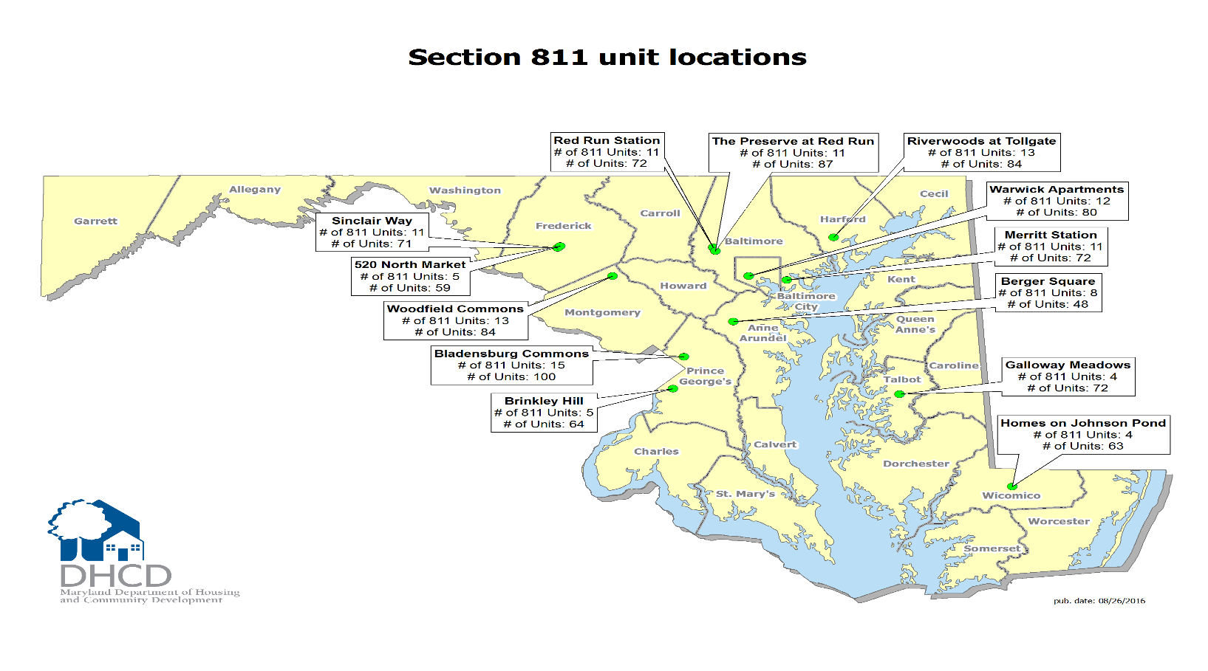
Section 811 Unit Locations
Notes:
Diane

Slide 55
Resources
Agency or Online Tool | Website
Social Security Administration | www.ssa.gov
US Department of Housing and Urban Development | http://portal.hud.gov/hudportal/HUD
Consumer Credit Counseling Services of Maryland and Delaware | www.CCC-inc.org or 1.800.642.2227
Annual Credit Report | www.annualcreditreport.com or 1.877.322.8228
Guide to Expungement of Nuisance Crimes | http://www.courts.state.md.us/district/forms/criminal/dccr072a.pdf
Maryland Judiciary Case Search | http://casesearch.courts.state.md.us/inquiry/inquiry-index.jsp
Disability Rights Maryland (MDLC) | https://disabilityrightsmd.org/
Public Housing Authority Locator | http://www.hud.gov/offices/pih/pha/contacts/states/md.cfm

Slide 56
Resources
Agency or Online Tool | Website
Housing Choice Voucher Guidebook | http://portal.hud.gov/hudportal/HUD?src=/program_offices/public_indian_housing/programs/hcv/forms/guidebook
Craigslist (Furniture, Apartment, Roommates) | www.craigslist.com
Weinberg Initiative | http://mdod.maryland.gov/housing/Pages/MPAH.aspx
HUD Section 811 PRA Demo. | http://www.dhcd.maryland.gov/Website/Programs/Section811/Default.aspx
Baltimore Free Store | http://freestorebaltimore.org/
SNAP Program/Food Stamps | http://www.dhr.state.md.us/blog/?page_id=5514
Go Section 8 | www.gosection8.com

Slide 57
Resources
Agency or Online Tool | Website
MD Housing Search | www.mdhousingsearch.org
Social Serve | www.socialserve.com
Fair Housing Act | http://portal.hud.gov/hudportal/HUD?src=/program_offices/fair_housing_equal_opp/FHLaws/yourrights
Reasonable Accommodations | http://www.hud.gov/offices/fheo/library/huddojstatement.pdf
MD Motor Vehicle Administration | 410.768.7442 or www.mva.maryland.gov
Area Median Income | http://dhcd.maryland.gov/website/programs/prhp/Documents/2013_MD_Income_Limits.pdf
MARYLAND CENTERS FOR INDEPENDENT LIVING (CIL) | http://www.msilc.org/map.html

Slide 58
Contact
Russell T. Springham, LCSW-C
Case Management and Housing Coordinator
Maryland Department of Health
Behavioral Health Administration
Clinical Services Division
Office of Evidence-Based Practice, Housing, and Recovery Supports
Spring Grove Hospital Center — Dix Building
55 Wade Ave., Catonsville, MD 21228
Phone: 410-402-8351
Email: russell.springham@maryland.gov

